Slide 1
Becoming a Confident Meetup Organizer in 8 Easy Years
A Reluctant Introvert's Guide

Slide 2

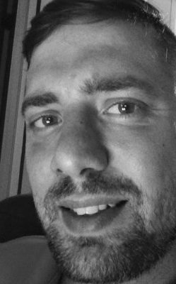
Jason van Brackel
Director of Community, Rancher Labs, INTROVERT

Slide 3
Why this talk?
I struggled becoming a professional
I tripped into speaking
I tripped into organizing

Slide 4
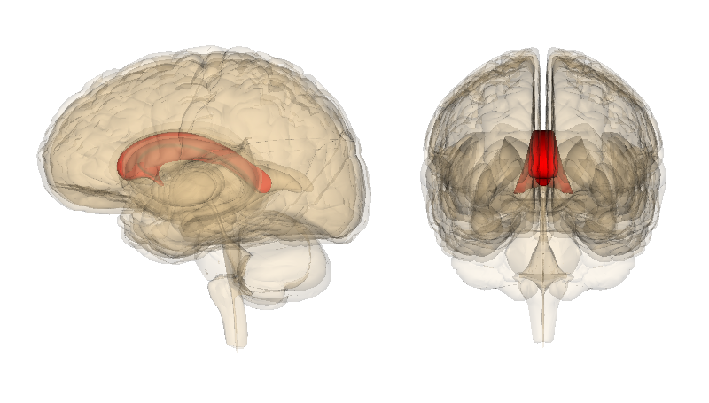
https://qbi.uq.edu.au/brain/brain-anatomy/corpus-callosum

Slide 5
My First Talk
Microsoft Access User Group

Slide 6
The Next Talk
Introduction to WPF – Central Penn .NET

Slide 7
Agenda
Fear
Presenting
Finding Time
Networking
Self Care
Organizing

Slide 8
Fear
Notes:
Panic Attacks as a Kid
Deep Breathing
Neurons tell you brain to relax self talk
Don’t be afraid to look stupid, be a little silly
Self Talk

Slide 9
Presenting
Notes:
Two Philosophies
Teach what you’re learning
Teach what you know

Slide 10
Teach what you’re learning
Advantages
Motivation
Encourages Learning
Polyglot
Disadvantages
Focus
Time Consuming
Hard to Brand Yourself

Slide 11
Teach what you know
Advantages
Giving
Repetition
Create a Brand
Disadvantages
Easy to get comfortable
Constantly Iterating
Motivation

Slide 12
Authoring a Talk
Outline
Think about how you learned this
Practice, Practice, Practice
At least as much as is reasonable. Have a life too.
Be Vulnerable
Notes:
This is all about empathy
For a 101 talk assume nothing
For something 201, review the basics quickly
There are left brained and right brained people. Right brains like pictures

Slide 13
Giving the Talk
Take a deep breath
Smile
Make sure people can hear you
Notes:
Stuff will go wrong
Internet will go out
Room might be noisy
Find you style

Slide 14
After the Talk
Network
Go watch yourself, if possible
Read the feedback, but don’t take yourself too seriously
Tweet, Blog, LinkedIn
Notes:
Get you some business card
Have a vCard setup on your phone

Slide 15
Finding Time
Stop Wasting Time!
Kanban
Pomodoro
GTD
Notes:
Should be enough time in the day to do everything and then some

Slide 16
Kanban
https://kanbanflow.com
Trello
White Board
Chalk Pain

Slide 17
Pomodoro
25 mins, intense focus
5 min break
Take 15 every 4 Pomodori

Slide 18
Getting Things Done
Inbox
Next Actions
Weekly Review
Lists
Someday
Maybe
This Year
43 Folders
Find a System that works for you
Notes:
The ONE Thing
The Power of Less

Slide 19
Networking
Social Media
Blogging
Be a Giver
Be Humble
Notes:
Be willing to be vulnerable
Specialization > Full Stack

Slide 20
Self Care
Professional
Personal

Slide 21
Professional
Take Vacation
No Job is Worth Your…
Notes:
Take vacation
Turn off technology
Spend time with Friends and Family
Tests the limits of unlimited vacation

Slide 22
Personal
Take care of your shit!
Taking Meds and Getting Counseling is not weakness!
Notes:
When you’re vulnerable stuff is going to come out

Slide 23
Organizing
Ask for help
Know when to say yes
Know when to say no
Set Goals
It’s not about you!
It’s not about your company

Slide 24
Be a Reader
GTD
The Phoenix Project
The DevOps Handbook
The 5 Dysfunctions of a Team
Boundaries
Integrity

